Slide 1
STAT3612 Group Project
30-day All-Cause Hospital Readmission Prediction
PU Rui Ling
CHAN Hiu Yu LYU Zhi Heng WONG Wai Chak
JIANG Xiao
Notes:
Hi everyone, we are group 22 and we are please to give a presentation about our group project.
When we first start to investigate this task, a debate within our group has been raised.

Slide 2
Contents
ML-Based
VS
DL-Based ？
Notes:
Whether we should take the ml approach or a deep learning approach to do this task. Because naively thinking from our limited knowledge, nueral network seems very magic. What can’t AI do right? So we split into 2 ml and dl subgroups to explore strageties based on the booth sides.
Next we are pleased to share about what we have done, no matter it succceed or failed.

Slide 3
Contents
ML-Based
VS
DL-Based
Part I: Data Preprocess
Part II: Traditional ML Algorithm
Part II: Deep Learning

Slide 4
Data Analysis:
Data Statistics
Feature Selection:
Mallows’s Cp statistic
Correlation within features & between features and target variable
Feature Engineer
Part I：Data Preprocess

Slide 5
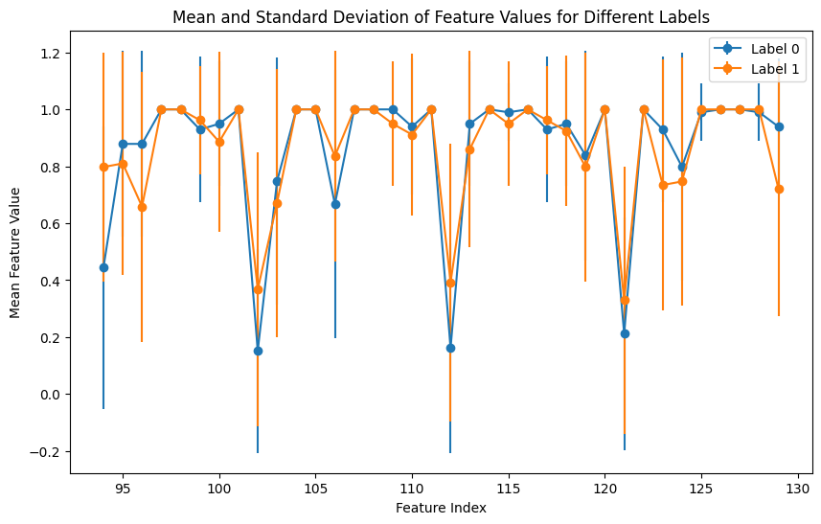
Data Analysis
Original dataset: Electronic Health Record (EHR)
（11596 patients and 171 features）
3 demographics (age, gender, and ethnicity)
91 ICD code features
36 lab test features→ only one vary with time
41 medication features
Comorbidity (n) | I: Infectious and Parasitic Diseases | 1630
 | R: Diseases of the Circulatory System | 747
 | D: Diseases of the Digestive System | 603
 | E: Endocrine, Nutritional, and Metabolic Diseases | 436
 | J: Diseases of the Respiratory System | 409
Age (Mean) |  | 66.23
Gender (%) | Male | 6337（54.65%)
 | Female | 5259（45.35%)
Length of stay (Mean) |  | 15.09 days

Slide 6
Feature Selection
Mallows’s Cp statistic
It quantifies the trade-off between model complexity and model fit.
Calculates and ranks the Mallows' Cp statistic for each feature.
The features are ranked based on their Cp values, with lower Cp values indicating more important features.
Correlation
Calculates the correlation coefficient within features and remove features with high multicollinearity. (several trials of threshold： remove if correlation > 0.7/0.6/0.8/0.85)
Calculates the absolute correlation between the remaining features and the target variable (readmitted_within_30days).

Slide 7
Feature Engineer
What we have tried:
Time series flatten:
Last day ✅
All days mean ❌
Last three days mean❌
Additional feature:
Length of stays ✅
SD of temporal features ❌
Gini impurity of temporal features over all days❌
ROC-AUC
❌ get worse/not improve
✅ better

Slide 8
Part II：Traditional ML Algorithm

Slide 9
Model Selection
We first tried 4 different ml models
Traditional Machine Learning Methods:
Logistic Regression (With L1/L2 )
Easy to interpret
2 Decision tree models: (XG Boost & Gradient Boost (Classifiers))
Ensemble learning and generalization ability
Incorporate non-linearity
A balance between interpretability and complexity
Proposed by the MIMIC extract paper (random forest had high AUC)
KNN

Slide 10
Model Fitting
Fit the models with default parameters on training dataset and compare validation AUC
 | Logistic Regression | Boosting
Capturing of non-linear patterns |  | √
Handling with high-dimensional data |  | √
Logistic Regression:
•Assumption of linear relationship for data
•Focusing on linear combinations of features instead of complex interactions.
•Low AUC and not many parameters to tune -> Drop
Gradient Boosting:
•Capturing non-linear features of data
•Tending to handle with high-dimensional data
•High AUC à want to proceed to tune parameters
Model | Validation AUC
Gradient Boosting | 0.7869
XG Boost | 0.7742
Logistic Regression | 0.76
KNN | 0.7464

Slide 11
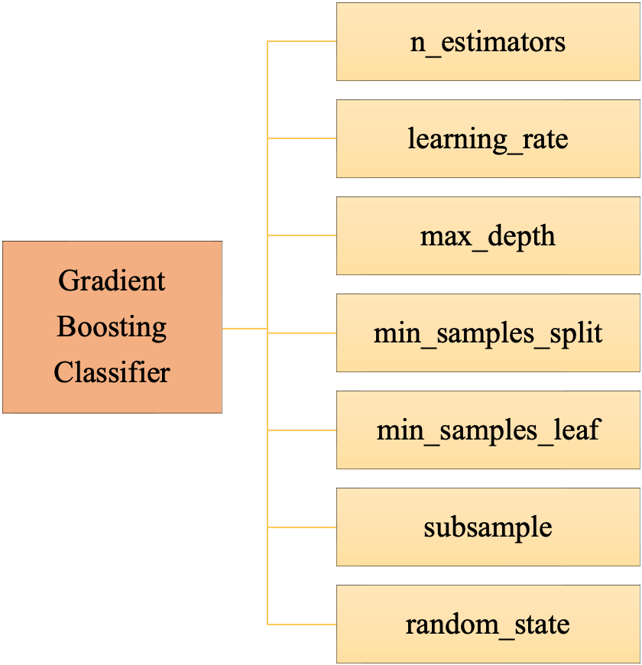
Understanding Parameters
Weak learner
Definition
Application
Example of parameter
In Gradient Boosting Classifier
Reason for adjusting

Slide 12
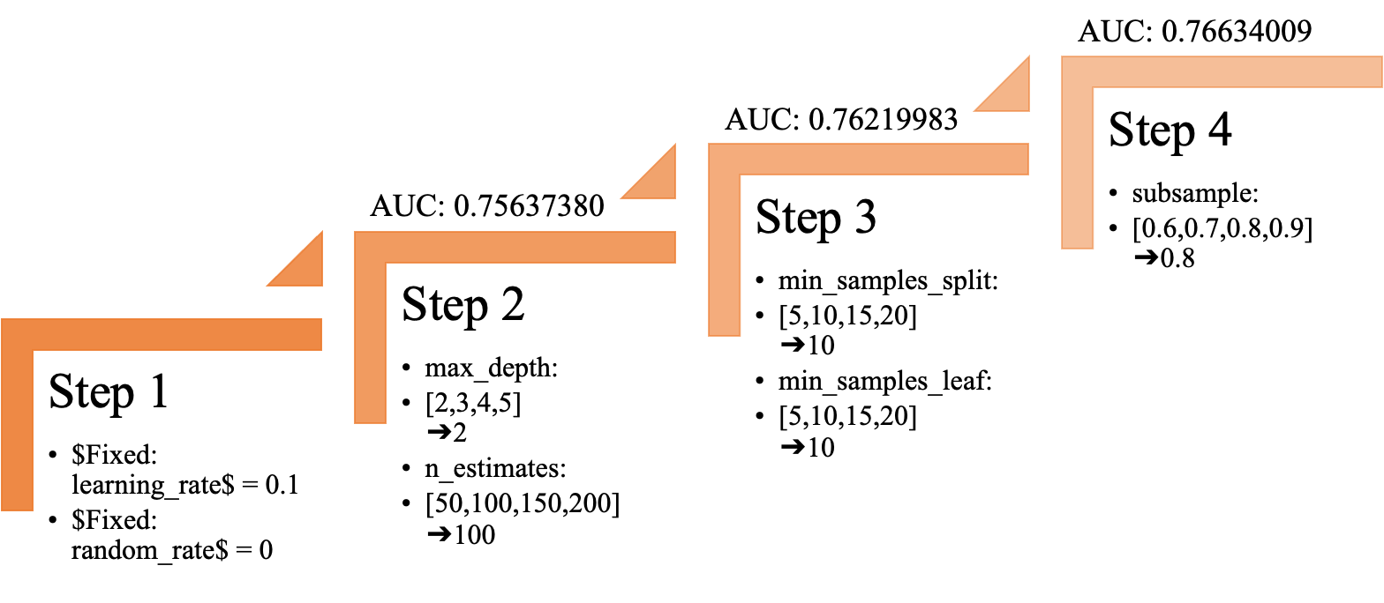
Parameters Tuning (Grid Search)

Slide 13
Results
Gradient Boosting | learning_rate = 0.1 min_samples_split = 10 min_samples_leaf = 10 max_depth = 8 max_features = ‘sqrt’ subsample = 0.8 | 0.7869
Xgboost | max_depth = 3 eta = 0.25 min_child_weight = 2 gamma:0.2 subsample=0.9 alpha=0.1 lambda=1.3 objective=binary:logistic | 0.7742
Logistic Regression | solver=saga max_iter=100 C=1e10 Penalty=l1 Class_weight=balanced | 0.7762
KNN | K=312 | 0.7494

Slide 14
PART III: Deep Learning Approach
Notes:
Now we can see that the gradient boost approach has achieved very good performance.

Slide 15
PART III: Deep Learning Approach
Neural Network
CAN
BEAT
Boost
？
Notes:
But can we use nn to ourperform it?

Slide 16
PART III: Deep Learning Approach
What we tried…
Neural Network
MLP
LSTM
Fusion-all pipeline
Similarity based method
Metric learning
GNN
Notes:
With this question, we further explore varies deep learning models.

Slide 17
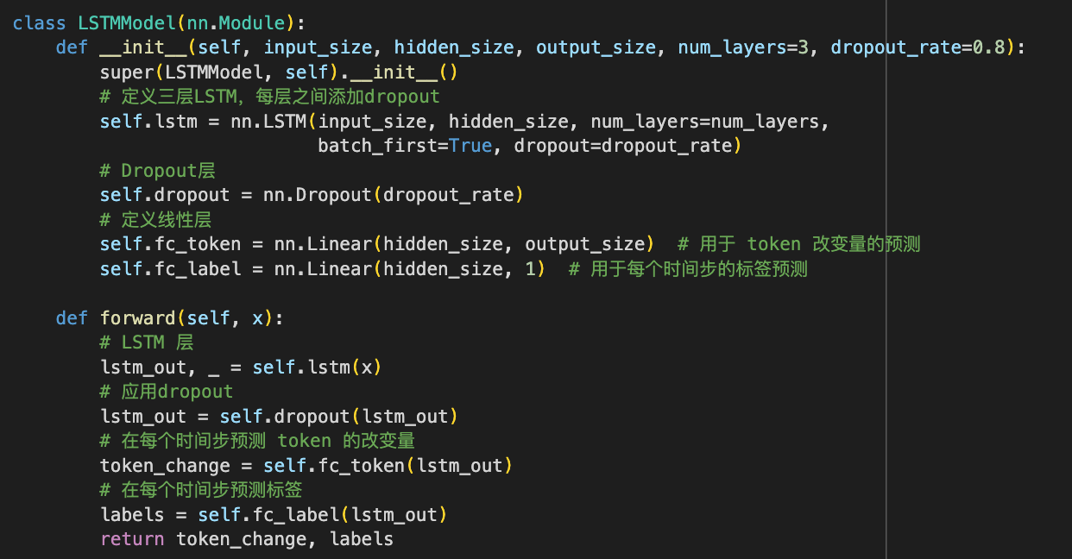
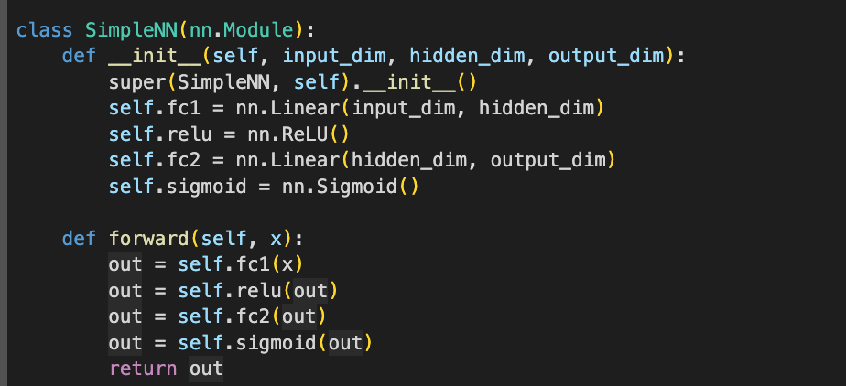
MLP and LSTM
LSTM
depth=3,hidden Size=64, weight decay=0.01
Loss 1: Prediction Loss (all tokens/last token)
Loss 2: Reconstruction Loss (pred the next timestamp)
MLP
2 linear layers + sigmoid (squash the output)
Notes:
First we tried MLP and temporal model LSTM. The mlp has to linear layers, and our LSTM has 3 layers. it was trained with prediction loss and reontruction loss, for token change prediction and label prediction at each timestep.

Slide 18
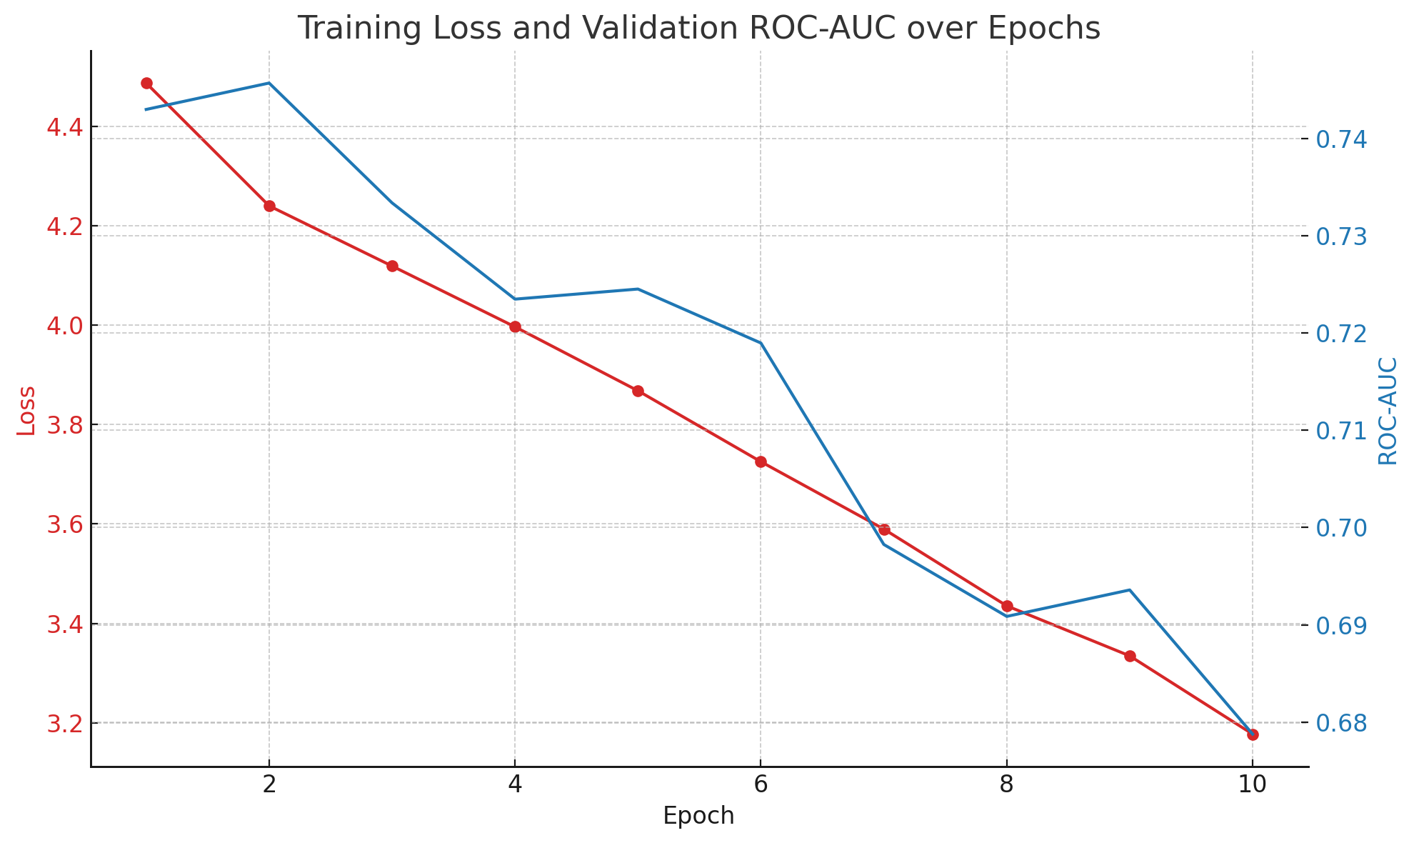
MLP and LSTM
LSTM:
Use all feature: ROC-AUC = 0.7456
Use all lab test feature: ROC-AUC = 0.7665
MLP:
Use all features → ROC-AUC achieved 0.7221
Use all static features → ROC-AUC achieved 0.6998
Notes:
LSTM achieved 0.76 when we only feed the lab test features to it. However, MLP has slightly lower performance with only .72 at most. When training our model, w found the AUC dd not increase which suggect the model is very esay to overft the dataset.

Slide 19
MLP + LSTM + Fusion layer
Method
Two groups of features:
static: X1: demo cols, ICD cols, med cols + length of stays →136 features
temporal: X2: lab cols → 36 features
X1 → MLP→ v1
X2 → LSTM→ v2
Concat (v1+v2) → MLP → Y
Observation
One BCELoss update all parameters → loss always fluctuated
AUC do not increase (overfit from the first epoch?)
Increase dimension of v1/v2 lead to very bad performance (eg. AUC < 0.5)
Even worse performance ROC-AUC only 0.6423
Notes:
Later one, we further tried some complicated pipeline. Since we observe that only the lab-test features are time dependent, so we split our feature into temporal group (lab test features), and static group, which is all of features except lab features + length of stays.
We then use MLP and LSTM to act as two encoders and output two internal vectors for this two kind of features, and then concatenate their output to another MLP. But this actually perform worse than any single one.

Slide 20
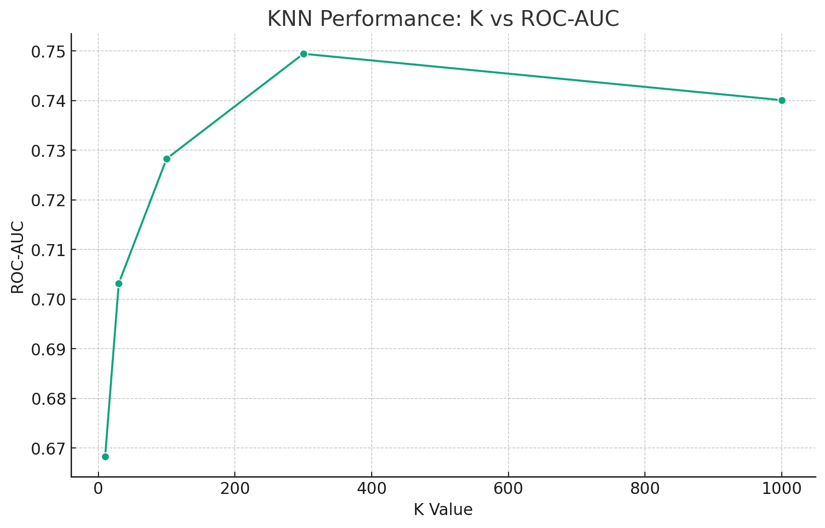
Similarity Based Method 1: Metric Learning
The Performance of KNN shows the potential of the method of similarity based method
Maximum ROC-AUC = 0.7494
Inspired by KNN, we want to narrow the distance between the same pair in adjacent nodes and distance different pairs in adjacent nodes on the basis of Euclidean distance.
After one epoch, ROC-AUC = 0.6554
It may be that the training data is too small and need hyper parameter tuning
naive idea, perhaps it is equivalent a simple neural network classifier
Notes:
After tuning our NN for many times, we cannot further increase the performance so we turned simlariity based method。We observed that the KNN can acheve a not bad performance, 0.74, uggest patients with similar features also lead to similar predctioin. So we use metric learning to narrow the distance between the same pair an ….
0.65.

Slide 21
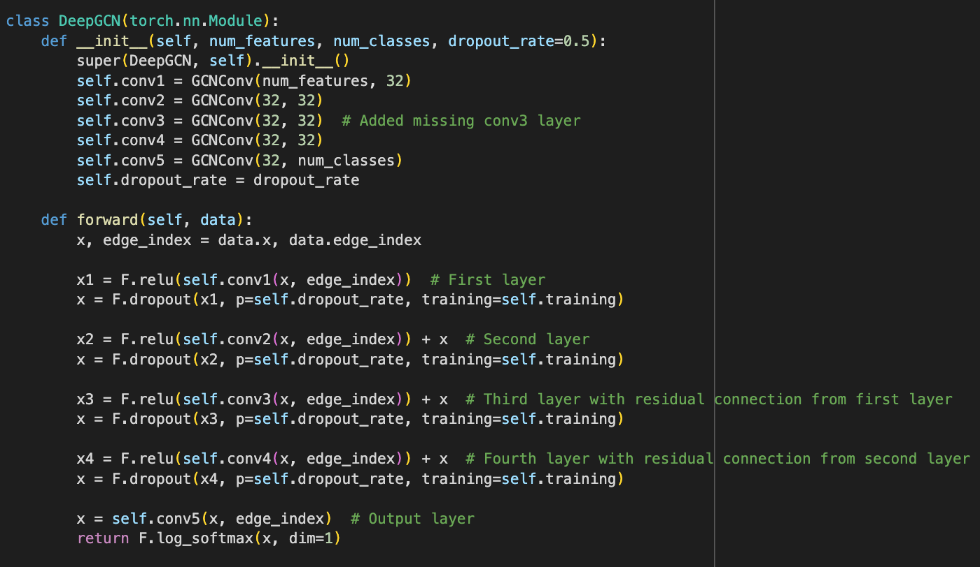
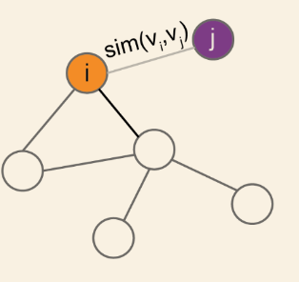
Similarity Based Method 2: GNN
Notes:
Another simlarity method we have tried s GNN. We frst construct a graph based on the patient information, where the edges is defined as the similarity between patient features.

Slide 22
Similarity Based Method 2: GNN
Using Graph Convolutional Network with Nearest 20 node have edge
After 400 epoch, ROC-AUC = 0.7118
Compared with Euclidean distance adjacency, higher-order adjacency is not so important here
If increase the number of adjacent edges more than 20, the graph convolution becomes smoother and vanishing grad.
Notes:
GCN is feed wth a graph where each node is connected to its 20 nearest neighbors. Actually this did not have a good performance. It finnaly acheved 0.7.
During training, we observe that, If the number of edges connecting each node to its neighbors is increased beyond 20, it seems that the graph convolution becomes smoother, which typically would mean that the features across the graph become more homogeneous. However, this also leads to the issue of vanishing gradients.

Slide 23
Conclusion
Model | Validation AUC
Gradient Boosting | 0.7869
XG Boost | 0.7742
LSTM | 0.7665
Logistic Regression | 0.76
KNN | 0.7494
MLP | 0.7221
GNN | 0.7118
Metric learning | 0.6554
Fusion | 0.6423
Neural Network CANNOT do everything 😇
Model performance:
Boosting still achieve highest AUC
LSTM and Similarity-Based Method showed competitive performance (despite very easy to overfit )
Notes:
After all this tries, we can see our dl approach cannot beat gradient boost, LSTM can only acheve slghtly better performance with logistic regression. SO this mght explained why our fusion network fail since t is just too complicated. Snce logistic regression iis enough.

Slide 24
Future work
Feature engineer + Simple ML model is powerful:
remove insignificant features, add more reasonable features
Neural network + Similarity based method ?
consider from different sides
Notes:
If we have chance to further improve our stagety, we may focus more on feature engineer to import the performance of boosting or LR. Maybe add several more features to reprensent thetemporal feature is enough, rather than let a nn to learn it. On the other hand, since our lSTM also have good performance, we may consider whether there is some way to combine their thrength together.

Slide 25
Thank you!

